Slide 1
APPLICATIONS AND USAGE OF VISUAL CRYPTOGRAPHY
Akshith -4200
Achuth -4066
Devendar - 4184

Slide 2
What is Visual Cryptography?
Visual Cryptography is a cryptographic technique which
allows visual information to be encrypted in such a way that
decryption becomes a mechanical operation that does not
require a computer.
Visual cryptography, degree associated rising cryptography technology, uses the characteristics of human vision to rewrite encrypted photos. Visual cryptography provides secured digital transmission that is used just for merely the once.

Slide 3
Why do we need Visual Cryptography?
Visual cryptography can be used to protect biometric templates in which decryption does not require any complex computations.
Cryptography is used in many applications like banking transactions cards, computer passwords, and e- commerce transactions. Three types of cryptographic techniques used in general.
Visual Cryptography is a wide area of research used in hiding, securing images, clolor imaging, multimedia and other fields.

Slide 4
How is cryptography used in Cryptocurrencies?
It uses the same secret key to encrypt the raw message at the source, transmit the encrypted message to the recipient, and then decrypt the message at the destination. A simple example is representing alphabets with numbers—say, "A" is 01, "B" is 02, and so on.

Slide 5


How Visual cryptography came into picture?
Data Security
Cyber crime(cyber theft)

Slide 6
Drawbacks
A strongly encrypted, authentic, and digitally signed information can be difficult to access even for a legitimate user at a crucial time of decision-making. The network or the computer system can be attacked and rendered non-functional by an intruder.
High availability, one of the fundamental aspects of information security, cannot be ensured through the use of cryptography. Other methods are needed to guard against the threats such as denial of service or complete breakdown of information system.
Another fundamental need of information security of selective access control also cannot be realized through the use of cryptography. Administrative controls and procedures are required to be exercised for the same.
Cryptography does not guard against the vulnerabilities and threats that emerge from the poor design of systems, protocols, and procedures. These need to be fixed through proper design and setting up of a defensive infrastructure.
Cryptography comes at cost. The cost is in terms of time and money.

Slide 7
Applications
Watermarking
Anti- Phishing System
Authentication for Data Matrix Code
Offline QR Code Authorization
Defense System
CAP-T-CHA
Signature Based Authentication
Fingerprint Based Authentication

Slide 8
Watermarking
Watermarking is a technique to protect the copyrights of digital media like image, audio, video, etc. Visual Cryptography (VC) is a scheme for hiding information in still images. The Visual Cryptography Scheme splits the secret image into unintelligible images, these images are called shares.

Slide 9
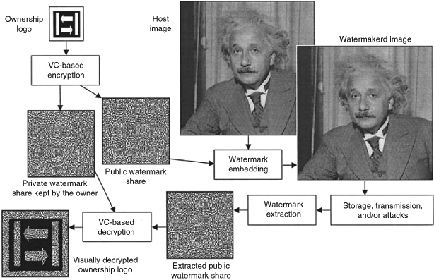
In embedding method, the watermark is divided by using visual cryptography technique . After dividing into share one share was embedded into the secret image’s frequency domain and another share is dispersed to the owner.
The share owner contains a share which helps to prove the ownership on the image and watermark like by combining the share which was the owner has and the other one which was embedded with original image at frequency domain Based on the visual cryptography technique the two shares don’t
reveal any kind of information about watermark.

Slide 10
Anti- Phishing System
As we know phishing is an attack which steals the sensitive information like passwords, pin numbers and other details by replicating the original website. By using visual cryptography technique to a website, a user can identify the difference between the duplicate website and an original website.
Fake web sites which seem fundamentally the same to the first ones are being hosted to accomplish this. In this paper we have proposed another approach named as “Anti-phishing system using visual cryptography in cloud” to take care of the issue of phishing.
This works as whenever a user tried to enter information then the website server sent a share to the user, then the user superimposes those two shares and then user get some code which was assigned.

Slide 11
Authentication for Data Matrix Code
This application applies two levels of security, it works on the identity cards.
Authentication goes through the owner’s identity card and in this level, it uses both DMC and shares of the facial image of the owner .
By comparing the shares from identity card and data base the user was identified then the identity card owner.
If the process doesn’t get any kind of information through the shares which are gathered from the card owner and from data base was superimposed, then the card owner doesn’t able to claim that he was the owner of the data.

Slide 12
Offline QR Code Authorization
This application was proposed by Fang and it is an algorithm which works on offline QR code authentication.
The QR code looks like a black square are randomly spotted on a white sheet.
Here in this application the author applied visual cryptography and the QR code will become into two shares and the share nearly looks like as QR code so it cannot be scanned by any third-party user and it is very easy and secure to do the transaction with QR codes.

Slide 13
Defense System
Generally visual cryptography encrypts the images into of two shares and the encrypted image was only decrypted by those shares only not with other shares .
This technique helps to encrypt all visual data like images, codes, handwritten text, etc.
This helps in defense to send a secret image like as follows.
First an image was encrypted into two parts and one part was directly given to the person who they want to send message and the other part was sent through the fax or in the form of printed when the time of using that code. And it helps to share the message secretly and in visually.
By using this technique, we can able to send more than two messages secretly to a person who works as a secret agent in a distance location and in a dangerous place, and the procedure to decode the data was only done by that person who receivethe share only.

Slide 14
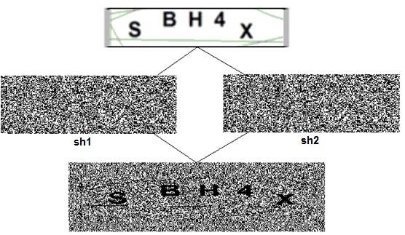
CAP-T-CHA
CAP-T-CHA is of three processes and work using the visual cryptography and the processes are as follows.
Shared Create Process
Hashed Codes Generated
Authentication Process

Slide 15
The utilization of visual cryptography is investigated to safeguard the privacy of a picture captcha by breaking down the image captcha into two shares (known as sheets) that are put away in separate database servers (one with client and one with server) such that the first picture captcha can be uncovered just when both are all the while accessible the individual sheet pictures do not uncover the character of the first picture captcha.
When the original picture captcha is uncovered to the client it can be utilized as the secret word.
Utilizing this site cross checks its character and proves that it is a certified site before the end clients.

Slide 16
If the two shares are matches and then stacked together and then removes noise from the share after that authentication will be accepted otherwise authentication will be rejected .
CAPTCHA is a standard security technology. To date, the most commonly used are various types of visual CAPTCHAs, in which a challenge often appears as an image of distorted text that the user must decipher.
The proposed scheme is used visual cryptography encryption protocol to encrypt CAPTCHA image in perfectly secure way, such that only the human visual system can easily decrypt the CAPTCHA image with animated arrangement.
Numbers of blurring image process are implemented on the CAPTCHA images, to make this test difficult for current computer systems. The new animated CAPTCHA is more secure than the current versions and easier for humans to pass.

Slide 17
Signature Based Authentication
This application is used in authentication process of an
employee. This works as follows first the employee was
registered here, after registration signature is taken and saved
After generating, that key share will be printed on the employee
identity card, and then if it matches the user can enter otherwise
the user is identified as an intruder.

Slide 18
Fingerprint Based Authentication
Fingerprint is one of the unique identifications of human and it is unique because every two humans doesn’t have the same type of fingerprint because of the ridges on the finger .
Authentication by using fingerprint helps us to do the operation very fast and easily and using visual cryptography in this system helps to protect the fingerprint from stealing from the database.
This application deals with self-operating methods of identifying and verifying and it consists of two processes, one is registration process and the second one is authentication process.
In the process of registration fingerprint considered as secret image and divided into two parts one is called as dummy share and other is called as participant share and the participant share is saved into user id.

Slide 19
In authentication process the id of user is inserted into the
scanner and it scans the participant share and superimposes that
share with dummy share in the database. If it matches, then
the user can able to authenticate.
If the participant and dummy share doesn’t reveal original
image, then the user doesn’t able to authenticate and easily
identified the unauthorized person.

Slide 20
References
Quist-Aphetsi K.ester, A New hybrid Asymmetric key-exchange Visual Cryptographic Algorithm tor Securing Digital images, 978-1 -4799-3067-8/13/$31.00 ©2013 IEEE
Hicham Tout, William Hafner “Phishpin: An identity-based antiphishing approach” in proceedings of international conference on computational science and engineering, Vancouver, BC, pages 347-352, 2009
Arafin, M. and Qu, G., 2018. Memristors for Secret Sharing-Based Lightweight Authentication. IEEE Transactions on Very Large Scale Integration (VLSI) Systems, 26(12), pp.2671-2683
International Journal of Science and Research (IJSR), 2015. A Review of Image Steganographic Technique Based On Extended Visual Cryptography Scheme. 4(11), pp.935-937.

Slide 21
Thank You

